Slide 1

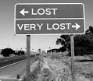
Meet Roman time traveller Marcus Losticus
Centuries later he has come back to Britain to visit the Roman roads and forts that he built in the good ole days

Slide 2


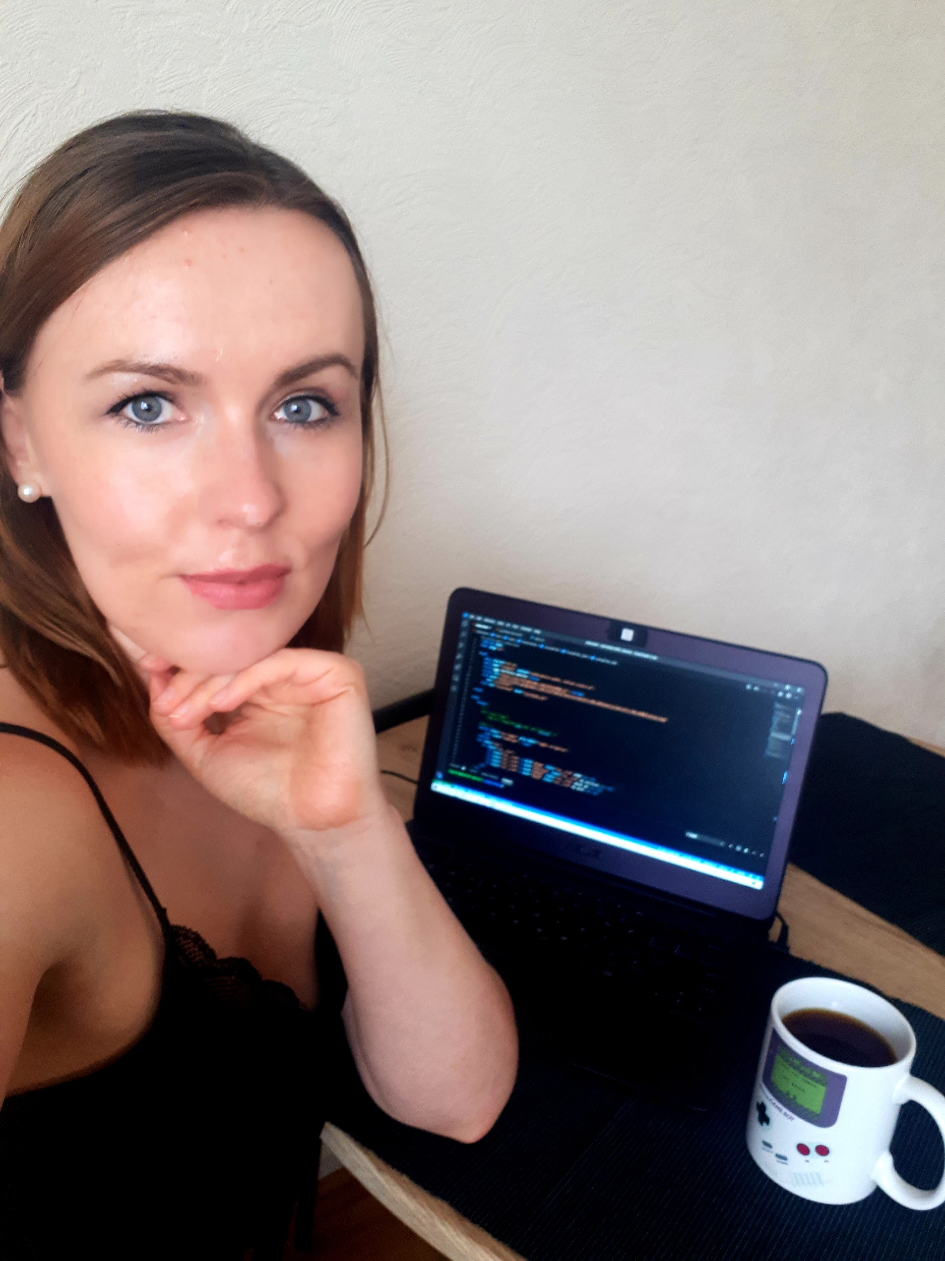

Lucky for Marcus, we stepped in to help him find his way around.
the Avengers
(we will place our pictures below)
Magda Fairfax
Ilga Kokorisa

Slide 3
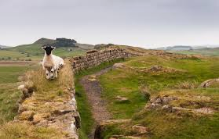
What we did:
We looked for information on old Roman roads and forts, and tried to find out if they still exist.
We wanted to know, if there is a relationship between the old Roman and modern roads in Britain.
(Please add our sources of information here)
Magda: To find data I used wikipedia and the following links:
https://projectmercury.eu/datasets/#roads
https://osdatahub.os.uk/downloads/open/Strategi
Ilga:
To create a map I used Mapbox (mapping software): https://www.mapbox.com/
To convert coordinates I used used Python library convertbng:
https://pypi.org/project/convertbng/

Slide 4

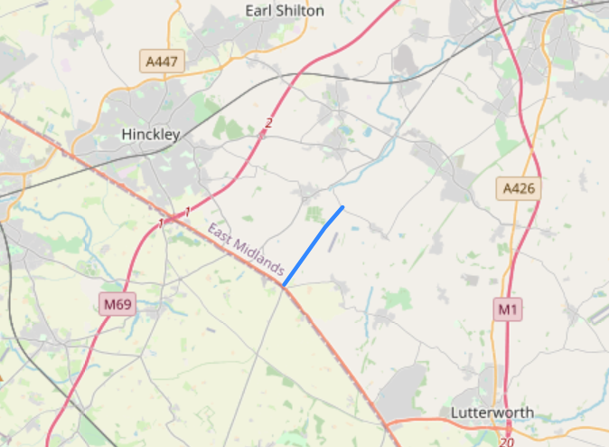
We found some interesting facts:
Between 43 and 410 AD, the Romans built approximately 2.000 miles of road in Britain.
The longest is Fosse Way, 220 miles. Many section of this road is being used today forming parts of modern roads and lanes.
(Please add more information) Magda: I used folium package in Python to put Foss Way
On to the map.

Slide 5
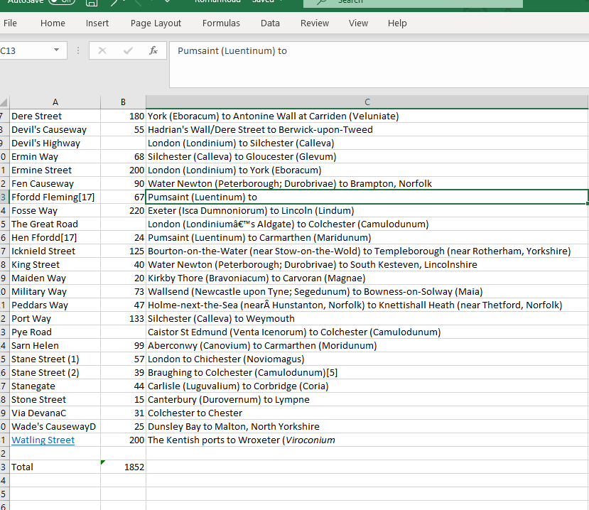
Magda: On wiki I found a all known roman roads and the approximative length. In total roman build approximately 1852 miles of roads. Impressive!

Slide 6
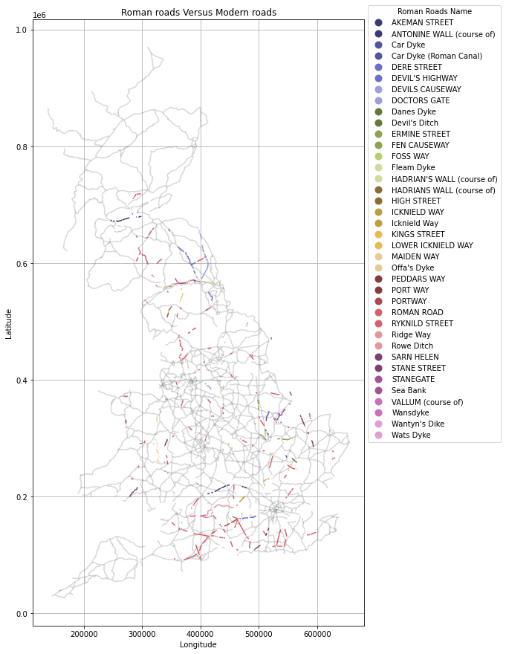
The relationship
between the Roman and modern roads
(Magda and Ilga please place the maps here)
Magda: In this map the grey lines represent the primary modern roads. On this map I superimpose the old roman roads still in use today in a colored schema.
With geopandas I calculate the total distance of roman roads and modern roads overlapping and if my calculation are correct I got 236117 meters which means 146.41 miles of roads still in use today.

Slide 7
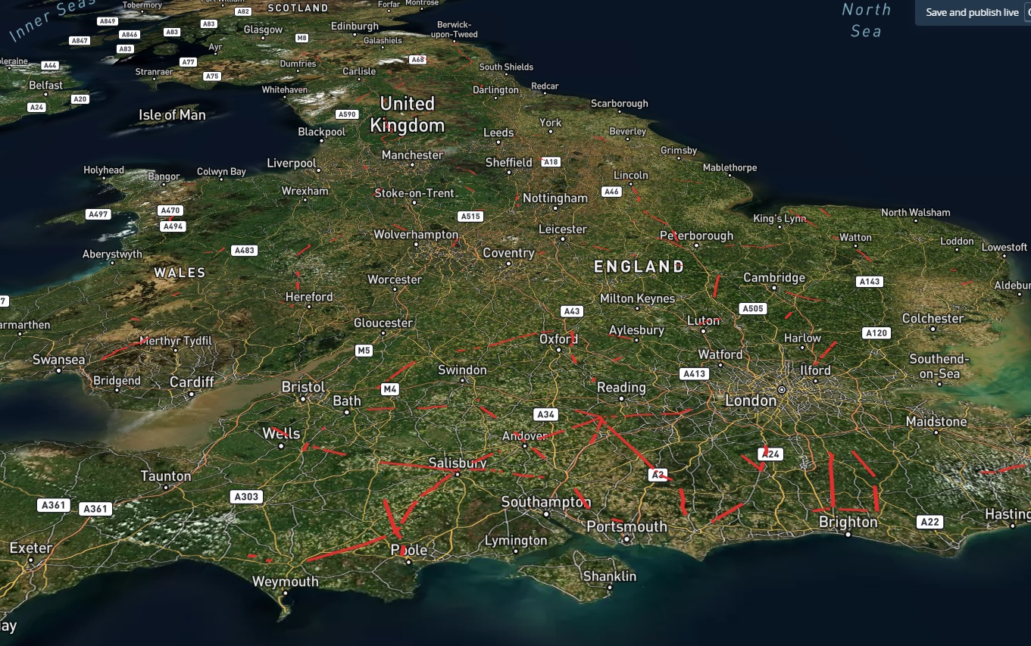
The relationship
between the Roman and modern roads by using Mapbox
I used the data (shapefile) which Magda found.
Converted shapefile to GeoJSON file.
Coordinates were converted from BNG to long/lat by using Python convertbng library.
Uploaded Roman Road dataset into Mapbox.

Slide 8
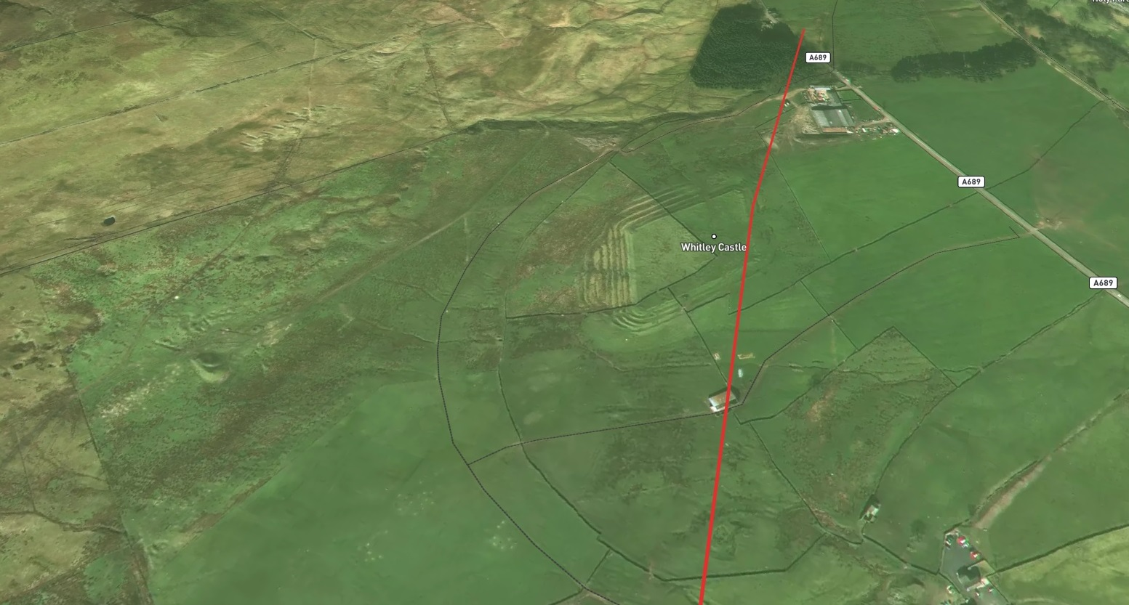
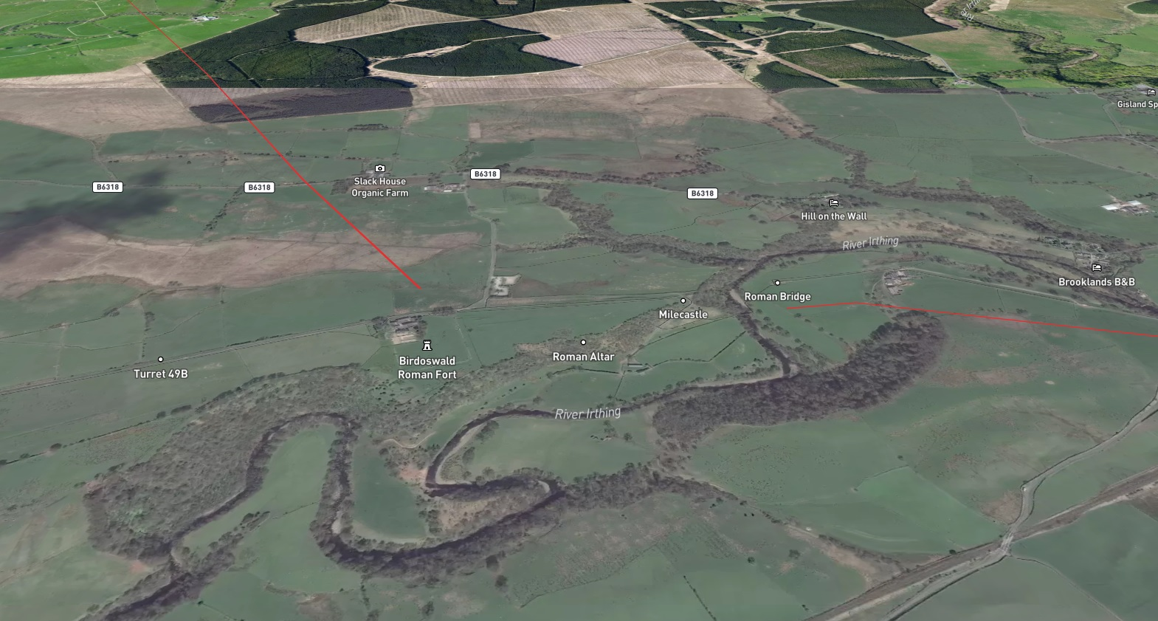
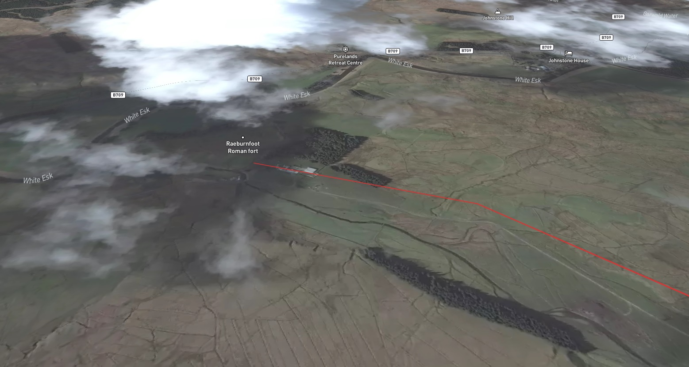
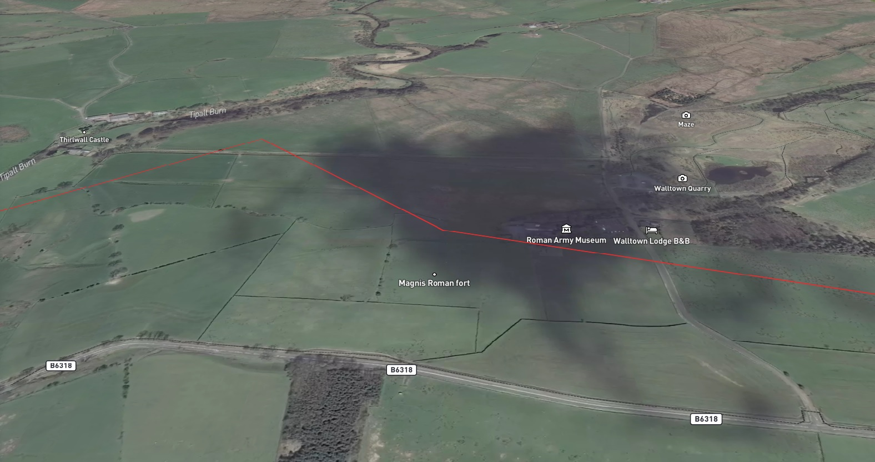
Whitley Castle, 2nd century AD
Birdoswald Roman fort, 122 AD
Raeburnfoot Roman fort (1st - 2nd century AD)
Magnis(Carvoran Roman fort)

Slide 9

what we learned
Magda: I learned and used geopandas package in Python and learn about the coordinate system (I never knew there are more than one)
Ilga:
First time used Jupyter Notebook and Jupiter Lab
Magda introduced me to Panda DataFrame
Learned more about geographic data structures (particularly GeoJSON)
First time tried to work with mapping software (Mapbox)
Hulu: I learned how to analyse findings - particularly, how to compare and connect different sets of data together; how to present findings to the audience in a clear and creative way.
(PLEASE ADD INFORMATION HERE)

